Slide 1
PCP1202 - UNIT 5
WEB APPLICATION USING ADVANCED DJANGO

Slide 2
Django Application - Extending the template System
Presented by,
Subalakshmi Shanthosi S

Slide 3
Session Metadata
Author | Subalakshmi Shanthosi S
Reviewer | Dr. R S Milton (Yet to be reviewed)
Version Number | 1.2
Release Date | 15 May 2019

Slide 4
Revision History
Revision Date | Details | Version no.
14 May 2019 | Custom tags and custom filters for templates | 1.1
15 May 2019 | 2. Custom FIlters and Templating tool experimentation | 1.2

Slide 5
Session Objectives
To understand the usage of simple custom template tags.
Understand how to use inclusion tags.
Working with custom filters for tags in template.
Handling complex custom tags.
Evaluating alternative templating methods.

Slide 6
Simple Custom Template Tags
def home_view(request):
img_files = os.listdir(settings.RANDOM_IMG_DIR)
img_name = random.choice(img_files)
img_src = os.path.join(settings.RANDOM_IMG_DIR, img_name)
# ... other view processing goes here ...
render_to_response(“home.html”, {‘img_src’: img_src})
<img src=”{% random_image “faces/thumbnails” %}” />

Slide 7
Simple Custom Tags contd...
import os
import random
import posixpath
from django import template
from django.conf import settings
register = template.Library()
def files(path, types=[“.jpg”, “.jpeg”, “.png”, “.gif”]):
fullpath = os.path.join(settings.MEDIA_ROOT, path)
return [f for f in os.listdir(fullpath) if os.path.splitext(f)[1] in types]

Slide 8
Simple Custom Tags contd...
@register.simple_tag
def random_image(path):
pick = random.choice(files(path))
return posixpath.join(settings.MEDIA_URL, path, pick)

Slide 9
Simple Custom Tags contd...
The template.Library instance gives us access to decorators that turn our simple functions into tags and filters that can be used by the template system.
The files function is a simple helper that gives us a list of filenames whose extensions indicate they are images.
The random_image function is executed when our tag is used in a template, passing the path from the template tag. It gets a list of image filenames in the provided directory via files, chooses one, prepends your MEDIA_URL to make a path suitable for use in an img tag,and returns that path.
The @register.simple_tag decorator on the random_image function.This turns our simple function into something that can be used by the template engine.
Save the snippet as randomizers.py - creating a custom template tag library.
INSTALLED_APPS/templatetags - image to be saved as this.
Or in TEMPLATE_DIRS/templatetags.

Slide 10
Simple Custom Tags contd...
Create empty __init__.py in templatetags directory to avoid errors.
{% load randomizers %} - to make the custom tag available for loading.
New random_image tag can take as an argument either a literal string or a template variable. So, for example, you could determine in your view at runtime the specific directory from which random images are drawn,and pass that to your template as image_dir.Then, your use of the random_image tag can look like this:
<img src=”{% random_image image_dir %}” />

Slide 11
Simple Custom Tags contd...
More Customisation:
@register.simple_tag
def random_file(path, ext):
pick = random.choice(files(path, [“.” + ext]))
return posixpath.join(settings.MEDIA_URL, path, pick)
<img src=”{% random_file “special/icons” “png” %}” />

Slide 12
Inclusion Tags
A simple_tag that used the template engine, but Django provides a more convenient and flexible option: inclusion tags.
Ex: Include {{ date }} in HTML
>>> import calendar
>>> calendar.monthcalendar(2019, 7)
[[1, 2, 3, 4, 5, 6, 7],
[8, 9, 10, 11, 12, 13, 14],
[15, 16, 17, 18, 19, 20, 21],
[22, 23, 24, 25, 26, 27, 28],
[29, 30, 31, '', '', '', '']]

Slide 13
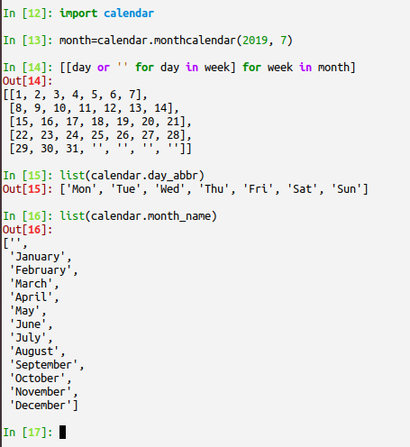
Inclusion Tags

Slide 14
Inclusion Tags
<table>
<tr><th colspan=’7’>{{ month }} {{ year }}</th></tr>
<tr>{% for dayname in daynames %}<th>{{ dayname }}</th>{% endfor %}</tr>
{% for week in weeks %}
<tr>
{% for day in week %}
<td>{{ day }}</td>
{% endfor %}
</tr>
{% endfor %}
</table>
Save as _calendar.html in TEMPLATE_DIRS

Slide 15
Inclusion Tags
@register.inclusion_tag(“_calendar.html”)
def calendar_table():
import calendar
import datetime
date = datetime.date.today()
month = calendar.monthcalendar(date.year, date.month)
weeks = [[day or ‘’ for day in week] for week in month]
return {
‘month’: calendar.month_name[date.month],
‘year’: date.year,
‘weeks’: weeks,
‘daynames’: calendar.day_abbr,
}
# Saved as inclusion_tags.py

Slide 16
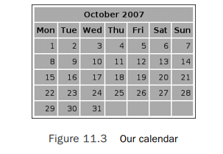
Inclusion of styling in _calender.html
<style type=”text/css”>
td, th { padding: 4px; width: 30px; background: #bbb; }
td { text-align: right; }
</style>
To load template :
{% load inclusion_tags %}
Usage:
{% calendar_table %}

Slide 17
Custom Filters
Filters are functions - Accepts strings and return strings
The files function is a simple helper that gives us a list of filenames whose extensions indicate they are images.
The random_image function is executed when our tag is used in a template, passing the path from the template tag. It gets a list of image filenames in the provided directory via files, chooses one, prepends your MEDIA_URL to make a path suitable for use in an img tag,and returns that path.
The @register.simple_tag decorator on the random_image function.This turns our simple function into something that can be used by the template engine.
Save the snippet as randomizers.py - creating a custom template tag library.
INSTALLED_APPS/templatetags - image to be saved as this.
Or in TEMPLATE_DIRS/templatetags.

Slide 18
Custom Filters
import re
from django.template import Library
from django.conf import settings
register = Library()
wikifier = re.compile(r’\b(([A-Z]+[a-z]+){2,})\b’)
@register.filter
def wikify(text):
return wikifier.sub(r’<a href=”/wiki/\1/”>\1</a>’, text)
CamelCase - within /wiki/CamelCaseWord

Slide 19
Custom Filters usage in template
{% load wikitags %}
<h1>My Amazing Wiki Page: {{ title }}</h1>
<div class=”wikicontent”>
{{ content|wikify }}
</div>
Filters with an Extra Argument :
For example, let’s say you want a function that displays a string only if that string contains a certain sequence of characters (think of this like the Unix command grep).You could accomplish this with if/then template tags, of course, but a filter would be much more compact.

Slide 20
Filters with an Extra Argument
{{ my_string | grep:”magic” }}
@register.filter
def grep(text, term):
if text.contains(term):
return text
{{ bla_bla_bla|hide_if_shorter_than:”100” }}
@stringvalue @register.filter
def hide_if_shorter_than(text, min_len):
if len(text) >= int(min_len):
return text

Slide 21
More Complex Custom Template Tags
More customized template.
Alternative Templating:
Code:
def simple_template_view(request, name):
template = “Hello, your IP address is %s.”
return HttpResponse(template % request.META[‘REMOTE_ADDR’])
Choosing an Alternative Templating Mechanism: Using Mako
Why different templating system ?
Convenient templating system
Common templating standards
Not translating templates imported from another project
Application logic- complex not easily presentable in template
Build in parameter!

Slide 22
Using Other Template Engines: Mako
Extremely fast templating.
Mako replaces the Python templating framework called Myghty, perl based.
Mako used in reddit and python.org, Pylons.
>>> from mako.template import Template
>>> t = Template(“My favorite person is ${name} ”)
>>> t.render(name=”Subalakshmi”)
“My favorite person is Subalakshmi”
>>> context = {‘name’: “Subalakshmi”}
>>> t.render(**context)
“My favorite person is Subalakshmi”

Slide 23
Using Other Template Engines: Mako
Wired up :
from mako.template import Template
def mako_view(request):
t = Template(“Your IP address is ${REMOTE_ADDR}”)
output = t.render(**request.META)
return HttpResponse(output)

